Slide 1

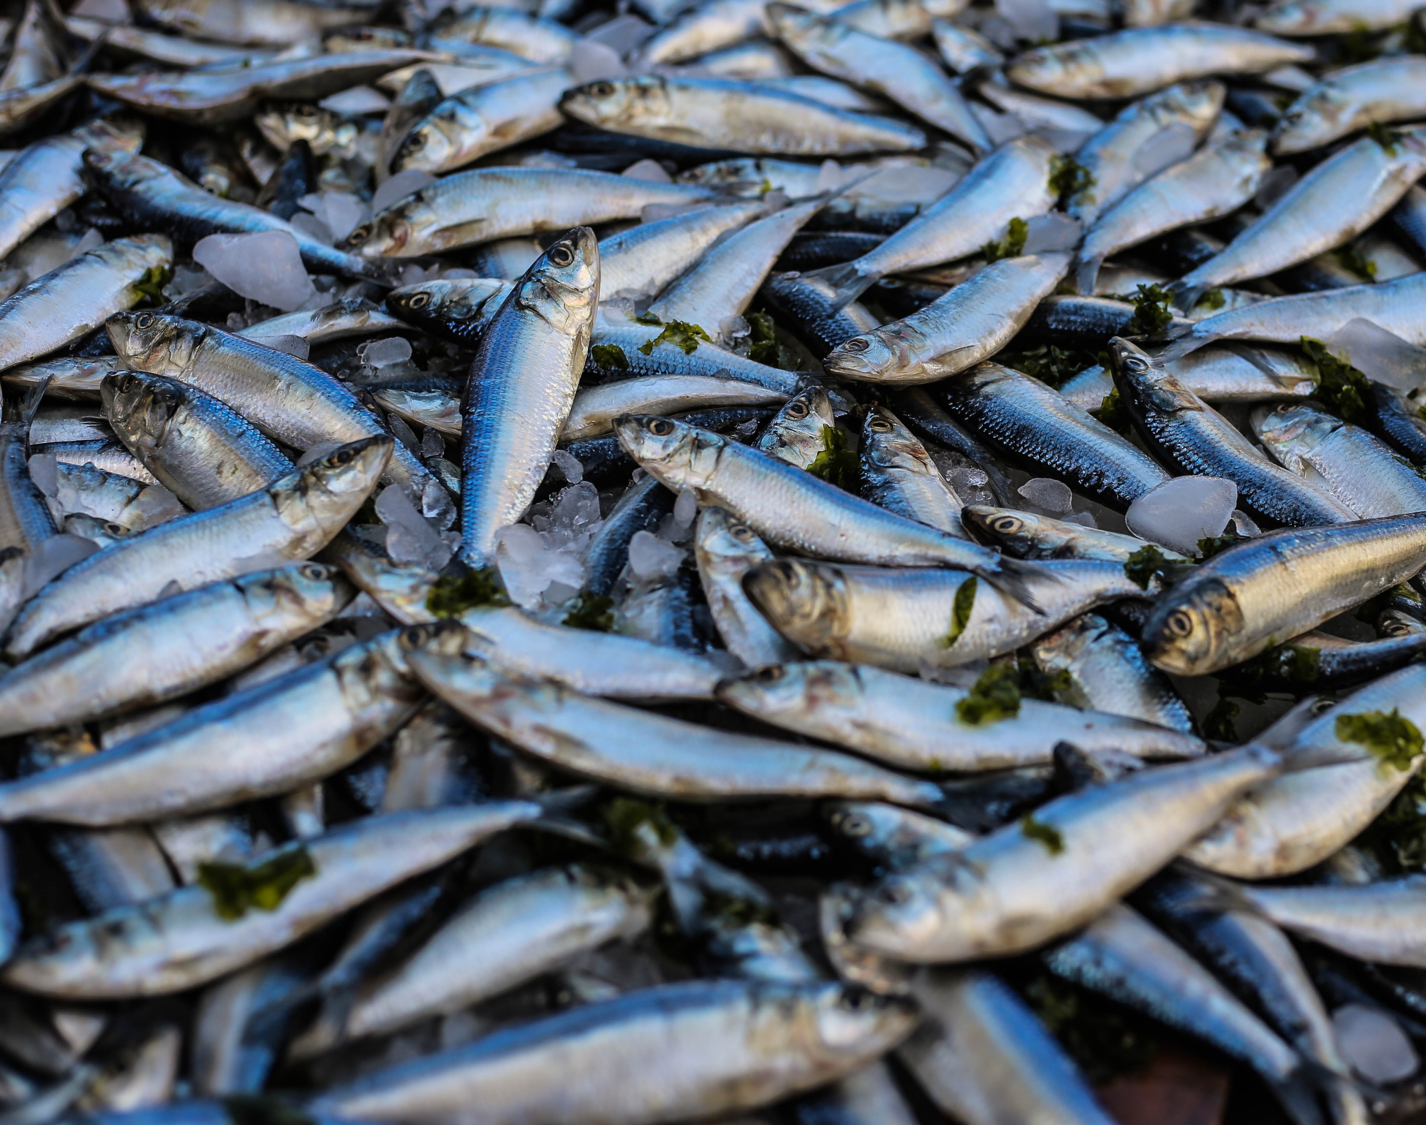
Aquaculture Case Study
POPULATION – RURAL TO URBAN VOLUNTARY MIGRATION IN SCOTLAND

Slide 2
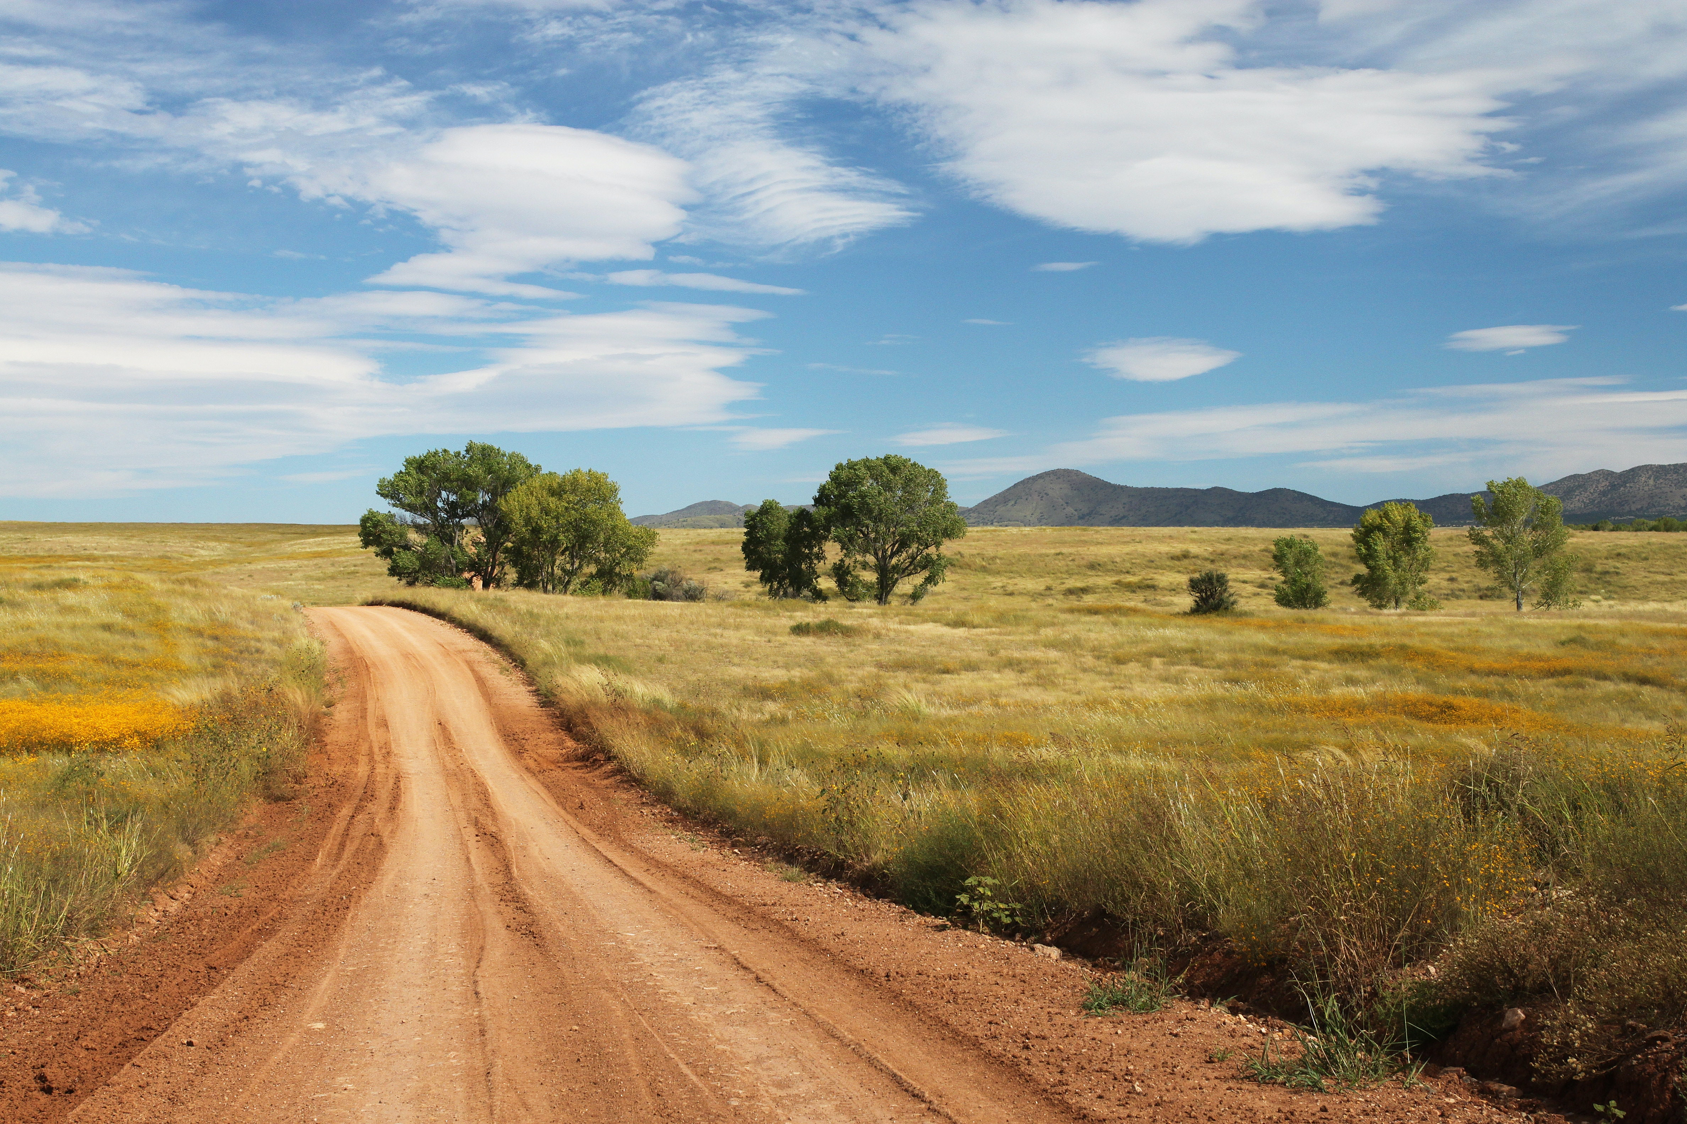
Population Patterns of Migration
Rural to Urban Migration Trend
70% of the 1.4 billion people living in extreme poverty, live in rural areas.
Rural-urban migration is the movement of people from the countryside to the city.
There is bigger marginalisation of rural communities, in comparison to urban communities, which is often why there is a trend of migration from rural to urban areas.
Rural communities struggle to keep skilled workers and often have lower paid job opportunities, resulting in higher rates of poverty in rural communities.
There is a general aim to sustain and better rural livelihoods “to leave no one behind” – reducing poverty and proving better opportunities (FAO).

Slide 3

PUSH AND PULL FACTORS
Causes of Migration in Rural and Urban Areas
 | Rural | Urban
Push | Poor access to transportation | Air pollution
 | Poorer paid jobs | Desire to be in countryside
 | Less accessible health care | Over population
 | Agriculture inefficiency | Slum areas
 | Poor access to education | Crime
Pull | Cleaner air | Better transport
 | Unspoiled scenery | Better paid jobs
 | Less Crime | More accessible healthcare
 | Close to nature | Better access to education
Development indicators: poverty, economy, access to healthcare, access to education, work opportunities, food security

Slide 4
Rural-Urban Migration in Scotland
Rural Areas in Scotland
Rural areas in Scotland account for 98% of the land mass in Scotland, being home to 17% of the population (Gov.Scot).
Scotland’s rural areas are predicted to lose a quarter of their population by 2046, with the working age population likely to shrink by 33% (The James Hutton Institute).
It has been acknowledging by the Scottish government that rural Scotland faces certain challenges and are looking to improve them.
Solutions
Aquaculture is one solution aiming to improve skilled job opportunities for rural communities.
Aquaculture has a critical role to play in protecting and strengthening Scotland’s rural communities and economy - now and in the decades to come.

Slide 5
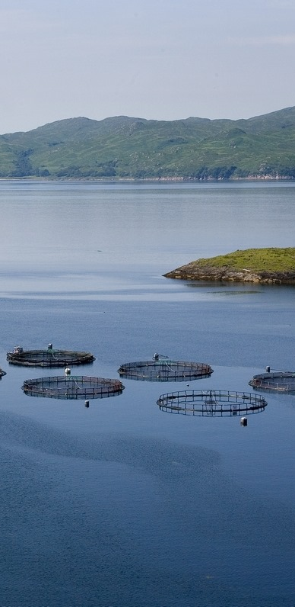
Aquaculture
What is Aquaculture?
“Aquaculture is the farming of aquatic organisms in both coastal and inland areas involving interventions in the rearing process to enhance production.” (FAO)
As overfishing is a major problem globally, the aquaculture industry farms their fish to prevent any further depletion of fragile wild fish stocks.
In Scotland, many fish are farmed such as: Atlantic Salmon, Rainbow Trout, Brown trout, scallops, oysters, mussels and seaweed.
Aquaculture is the fastest growing food-producing sector globally and now accounts for 50% of the world’s seafood (FAO).
Aquaculture is essential for the nutrition and employment of millions of people, who are struggling to maintain reasonable livelihoods in fragile communities.

Slide 6
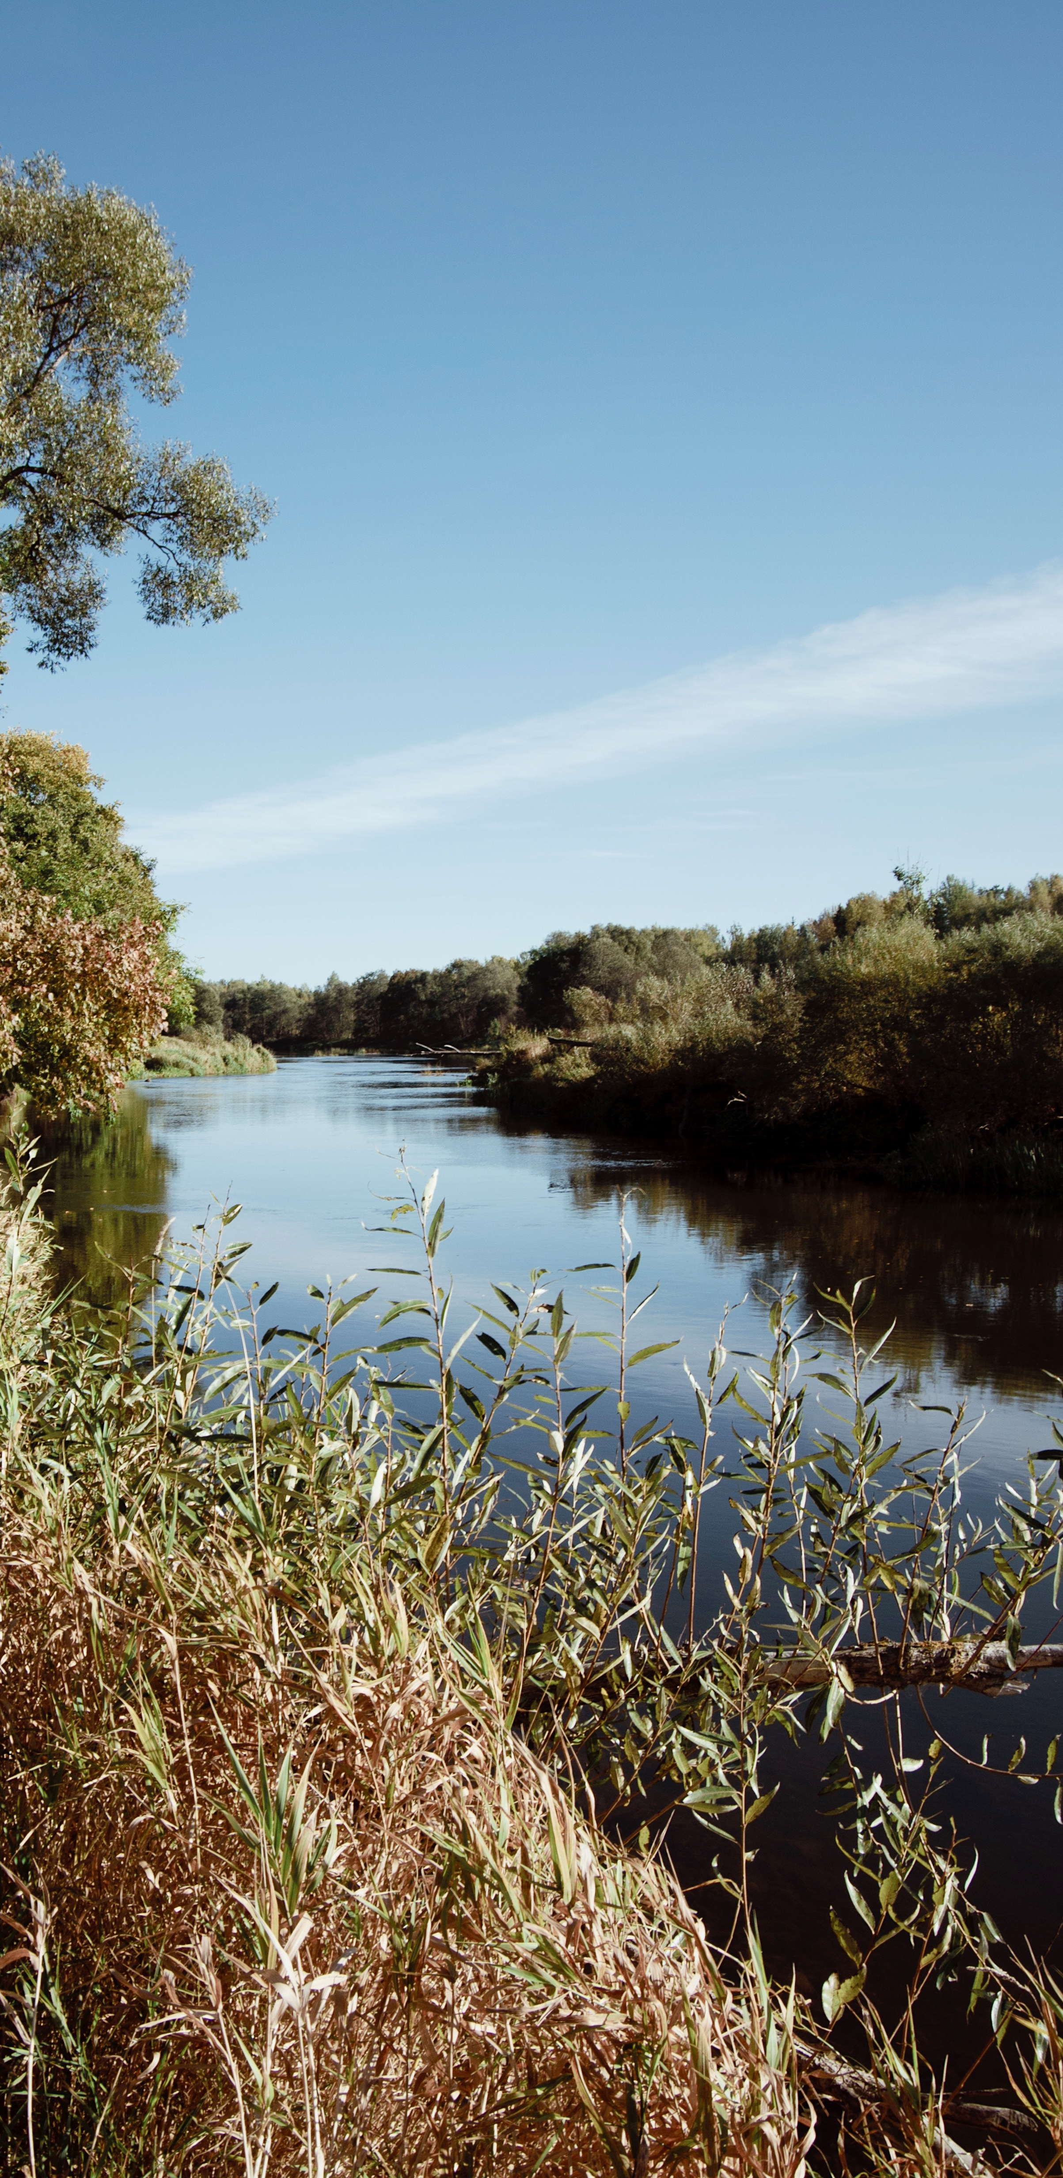
Rural Communities in Scotland
Aquaculture in Rural Scotland
Aquaculture has been a key part of rural industry over the past few years.
Without this industry, there is limited alternative economic growth options.
The goal is to produce more sustainable industries across Scotland in order to produce a sustainable future for rural Scotland.
Aquaculture wants to help rural and costal communities in Scotland by providing them with jobs that are considered as highly-skilled work.
Aquaculture gives millions of pounds into local rural communities every year through salaries and taxes (SSPO).
The sector directly employs 2,300 people along the west coast of Scotland, Orkney and Shetland, with 10,000 more people working in the supply chain relying on salmon farming's success for their own employment (SSPO).

Slide 7
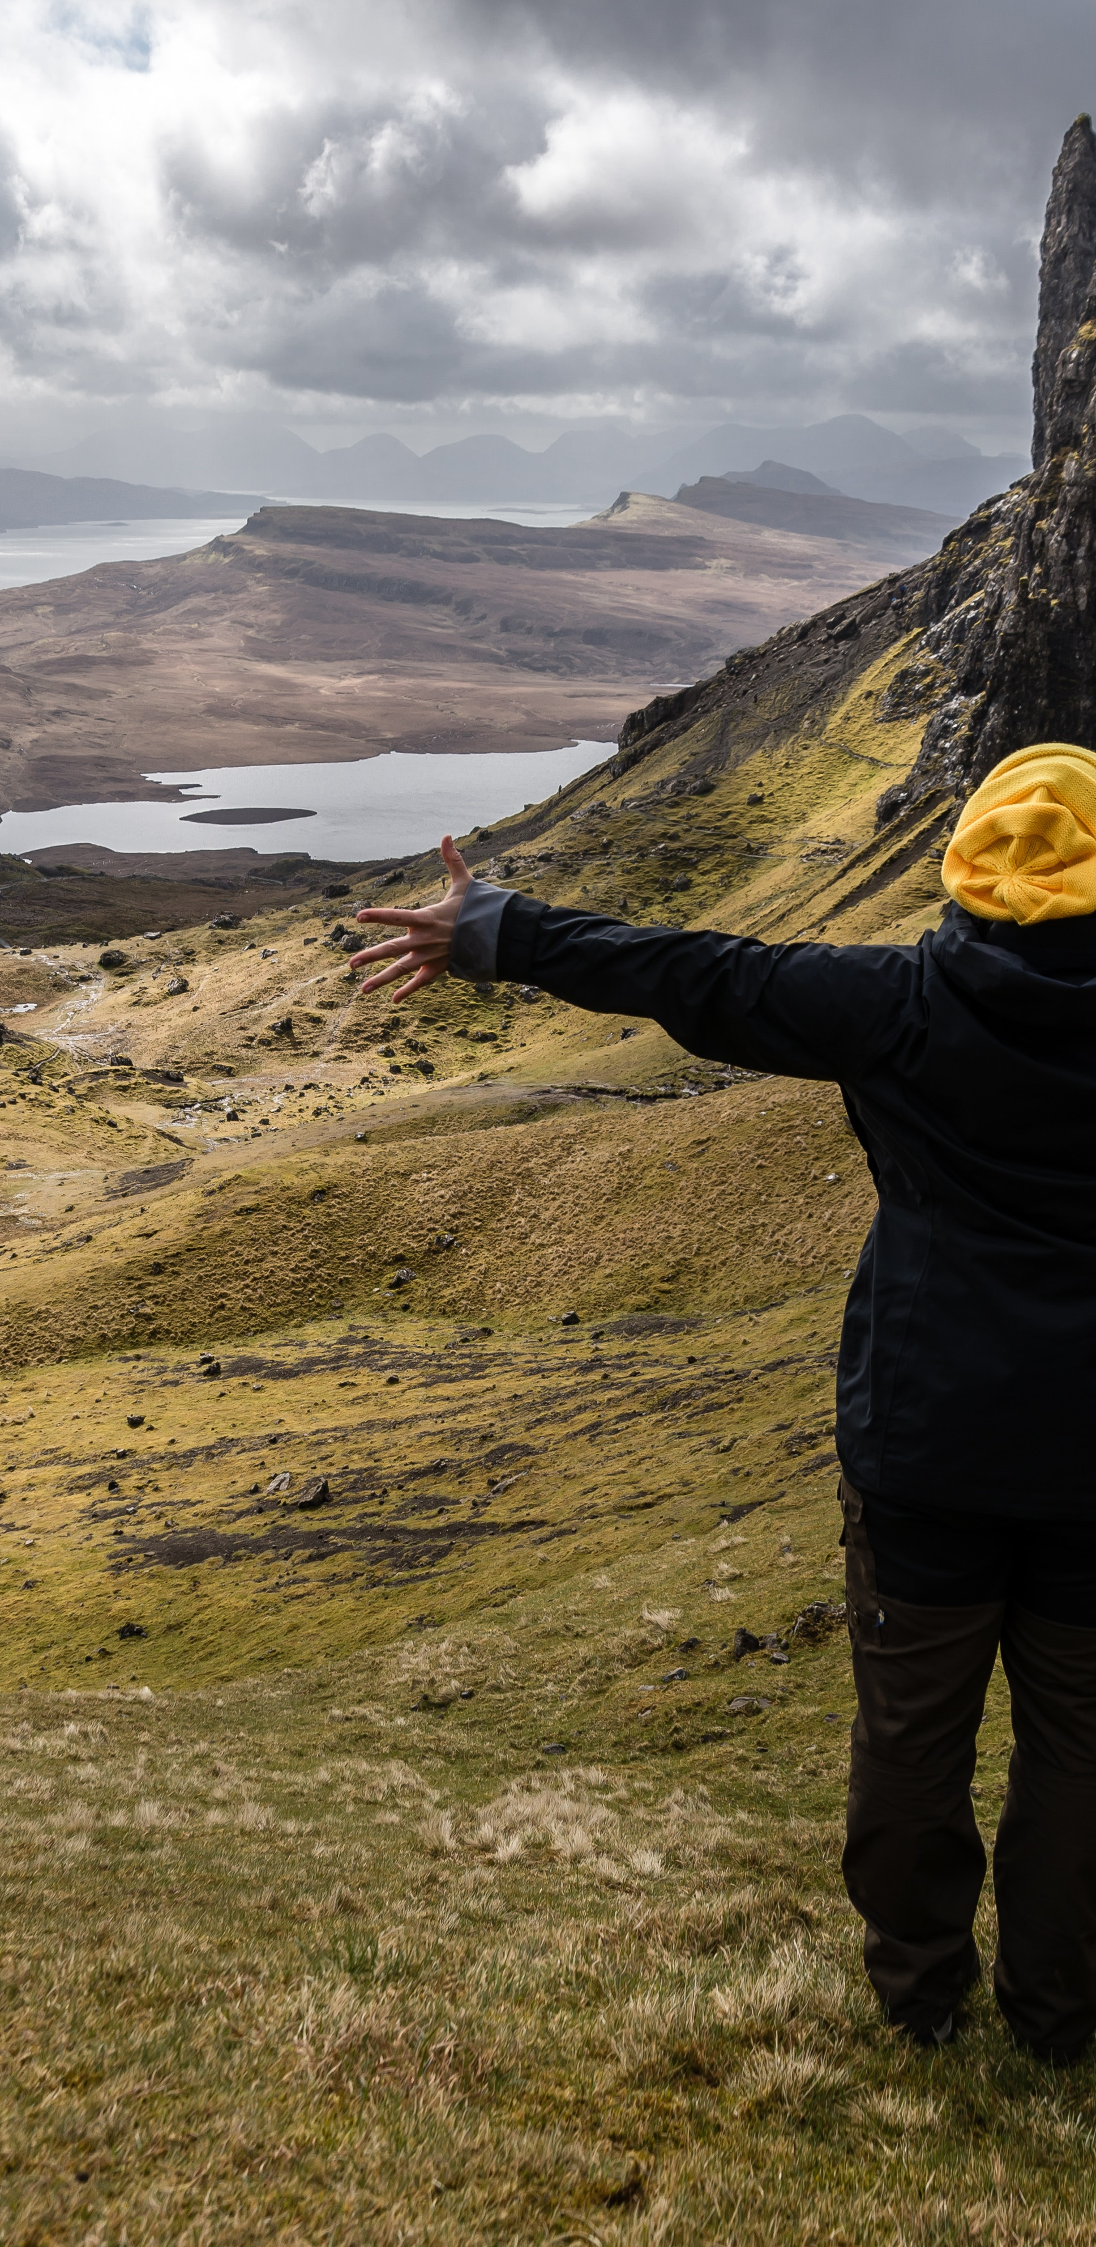

Rural Communities in Scotland
Benefits of Aquaculture
Aquaculturists invest both time and hundreds of thousands of pounds every year to support local causes in rural communities (SSPO).
In 2016 salmon producers contributed £735,000 to projects, including the renovations of community halls and refurbishment of school playgrounds.
Fish famers also have funded and created badminton and football teams, Jujitsu and Island Games squads, school swimming lessons and mountain bike champions. They see great importance of maintaining strong, healthy communities in remote rural locations (SSPO).
Salmon producers commit to operating “with transparency, openness, honesty and integrity” in their communities and to encouraging local engagement where possible, preventing marginalisation.
https://vimeo.com/247977055

Slide 8
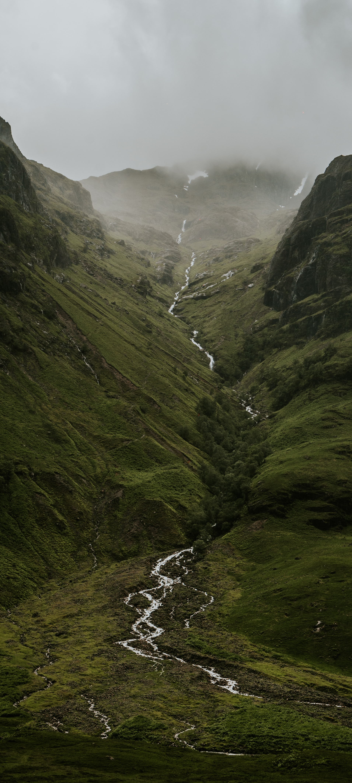
Rural Communities in Scotland
Benefits of Aquaculture
Aquaculture doesn’t only bring benefits to rural communities, but it is also a sustainable industry protecting the environment.
Introducing aquaculture promotes a more sustainable rural Scotland.
In comparison with terrestrial livestock farming, the industry has low carbon footprint and feed conversion ratio (FCR). It also has high protein and energy retention.
Aquaculture not only protects the environment but protects the fish they are growing. Good fish welfare is one of the most important parts of aquaculture.
https://vimeo.com/247779369

Slide 9


Aquaculture Needs Geographers
Help drive innovation and work on the front line to combat climate change and food insecurity.
Aquaculture offers many career opportunities for geographers.
Contact SAIC for more information on career opportunities.

