Slide 1
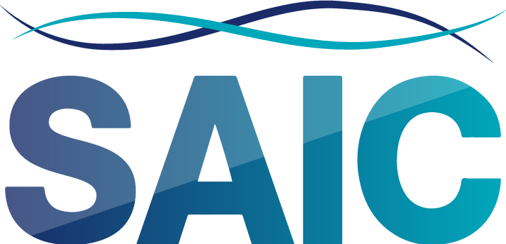
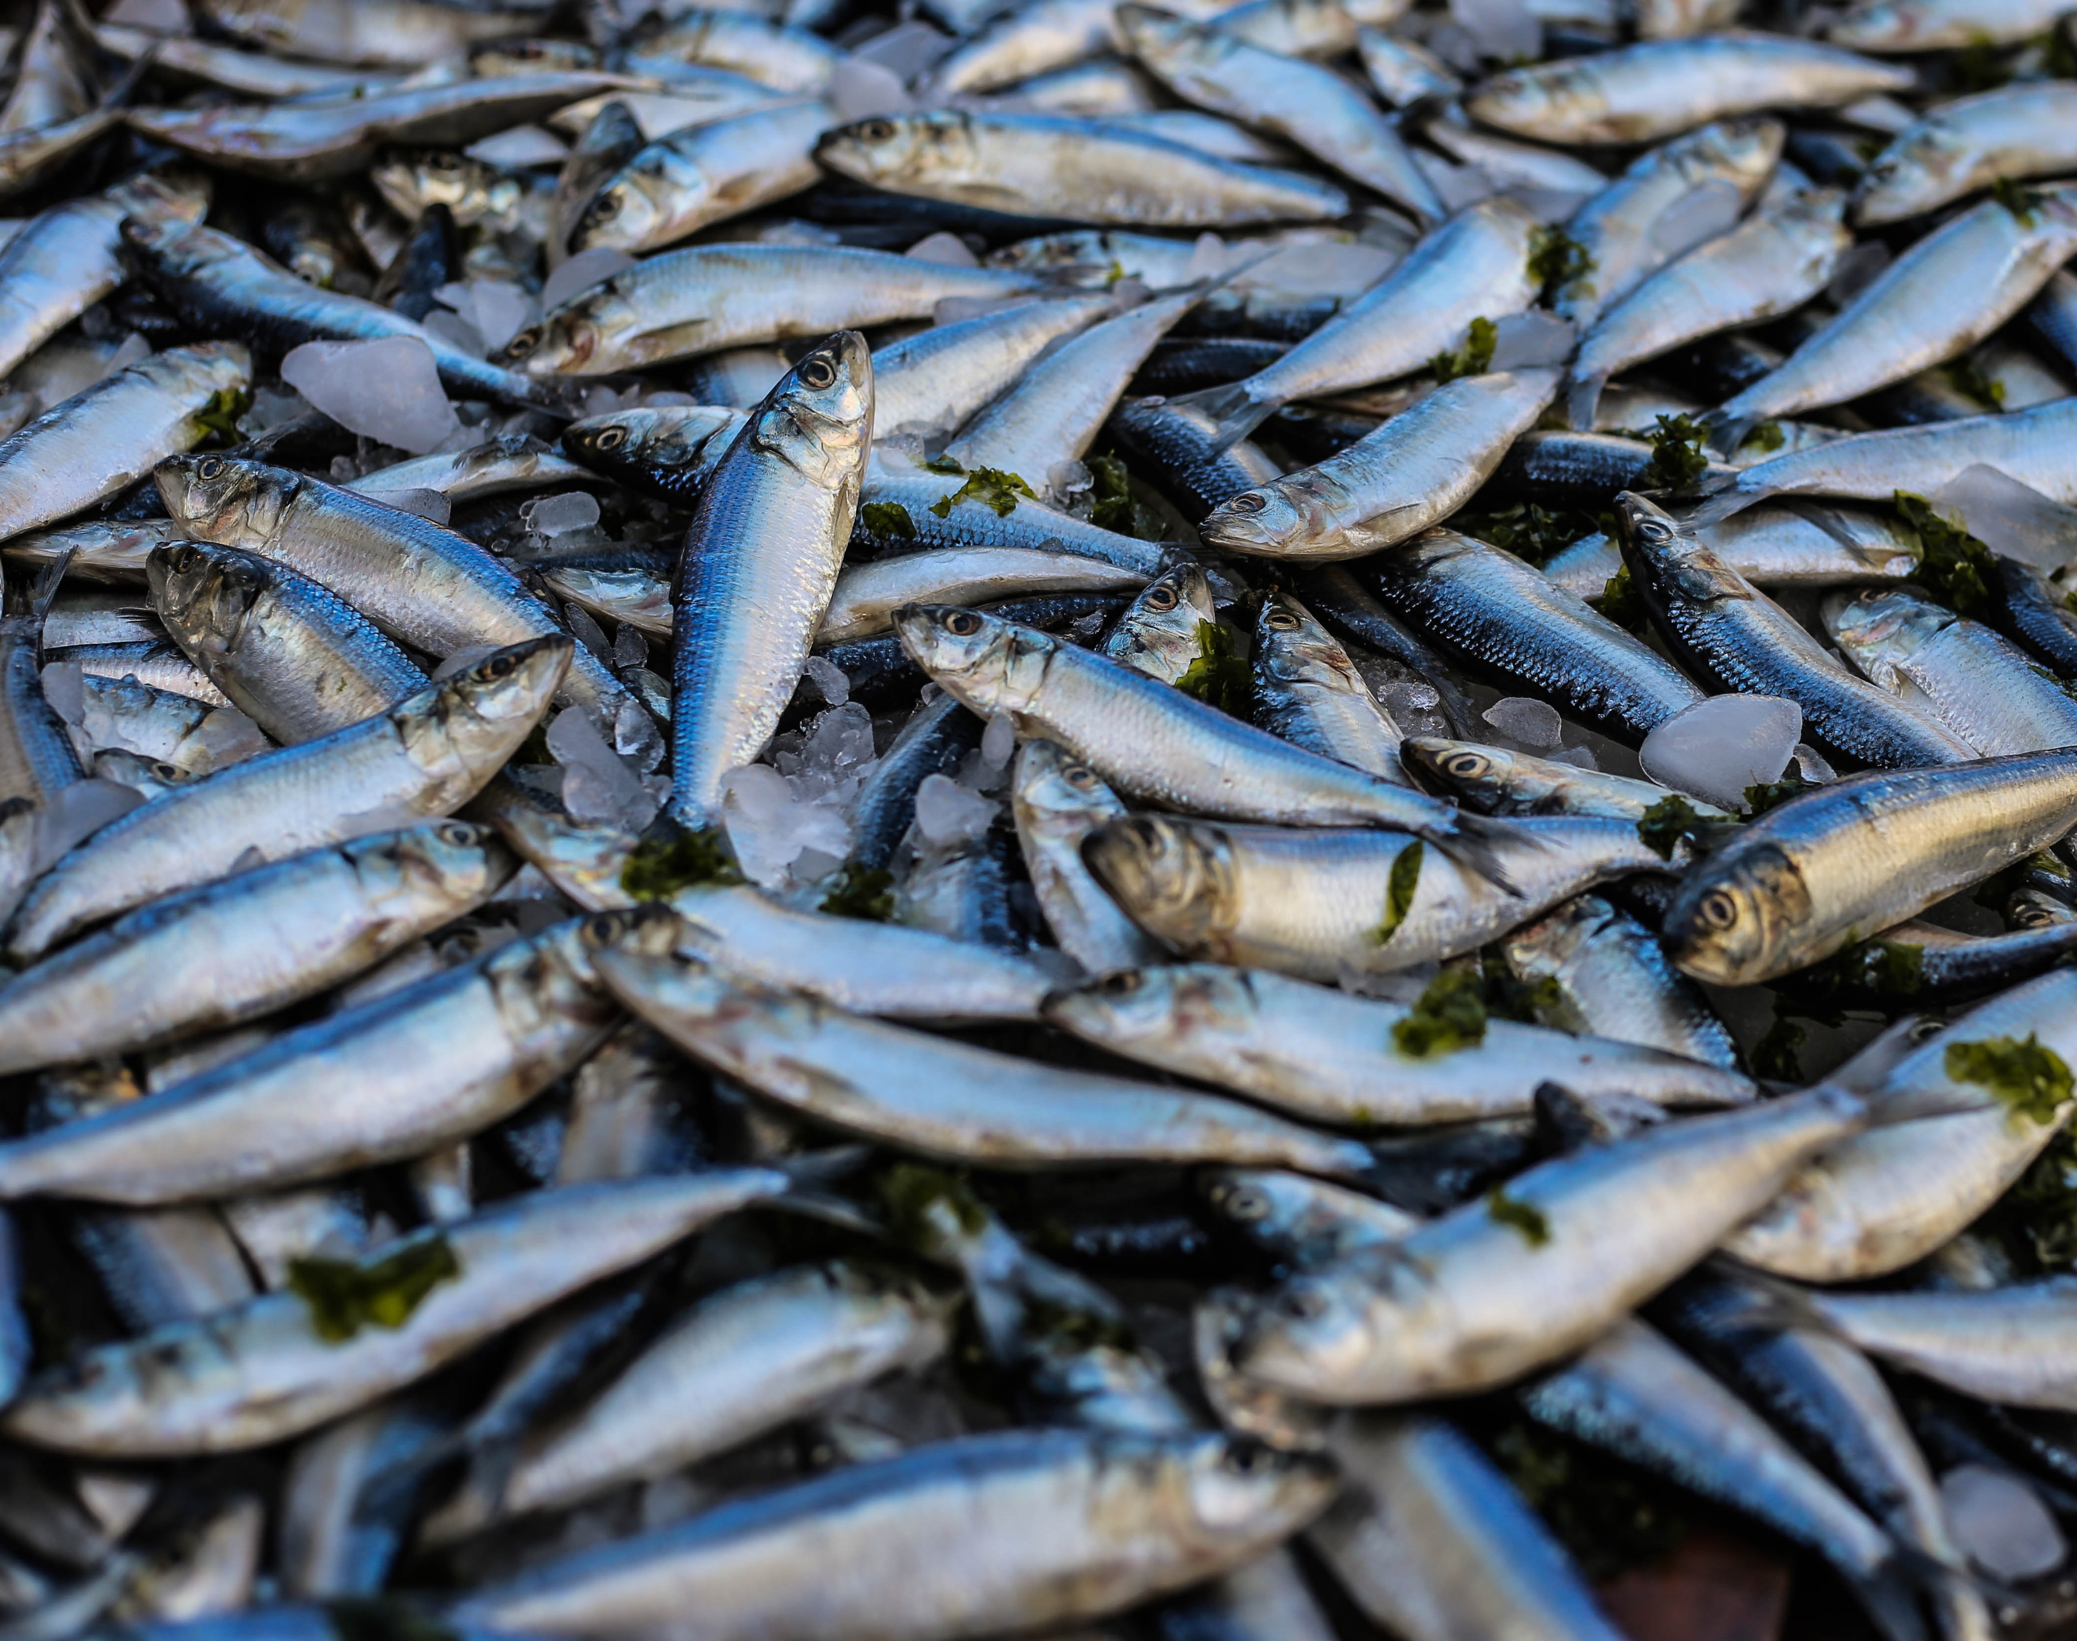
Aquaculture Lesson
The Blue Revolution

Slide 2
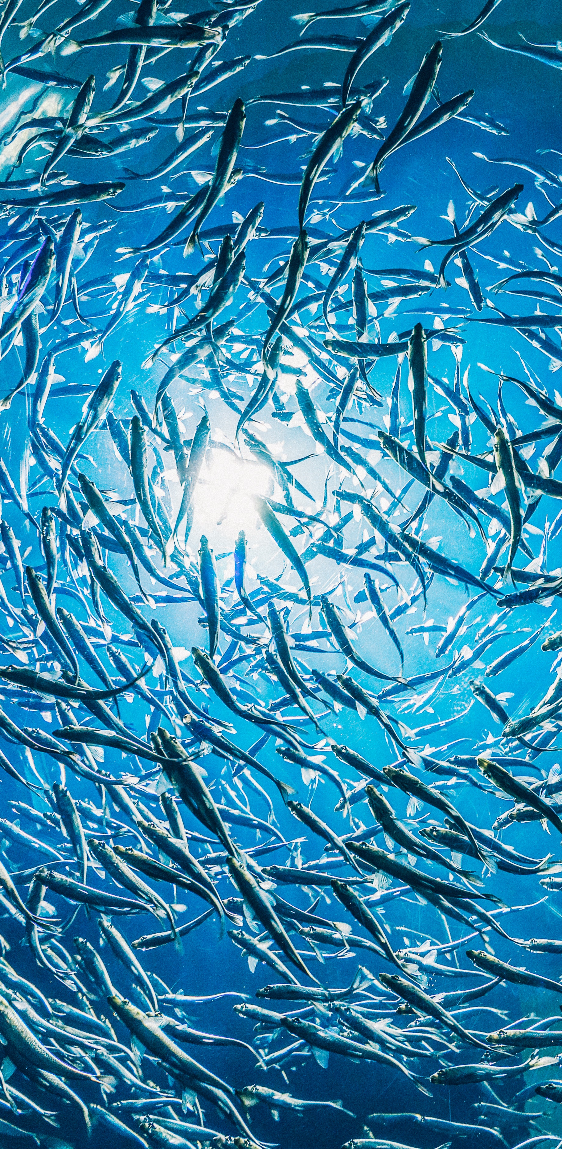
Green to Blue
What is the Blue Revolution?
The Blue Revolution refers to the period in time, where aquaculture industries grew rapidly worldwide, from the mid-1960s to present.
After the green revolution (the transformation in agricultural practices between 1940 and the 1960s), the blue revolution followed - trying to incorporate the successes and eliminate the weaknesses of the green revolution.
What is Aquaculture?
“Aquaculture is the farming of aquatic organisms in both coastal and inland areas involving interventions in the rearing process to enhance production.” (FAO)
It is a sustainable industry, aiming to tackle problems such as overfishing and food insecurity.

Slide 3

Mowi 360 experience
https://vimeo.com/307480495
AquaStorm
https://vimeo.com/337954771
The blue revolution: circular agriculture in aquaculture
https://www.youtube.com/watch?v=zfghYmDIc_o

Slide 4
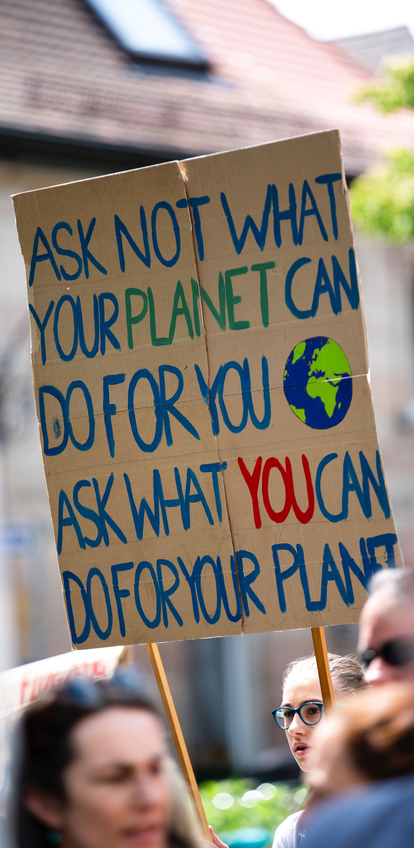
Sustainable Aquaculture
How is Aquaculture Sustainable?
Planet Earth is home to around 7.5 billion people, and this is expected to rise to 9.5 billion by 2050. A growing population means a bigger demand for food.
To deal with the projected 9.5 billion people, we need 70% more food and new sustainable ways of food production.
Aquaculture is the most efficient protein generator and is one of the most important long-term growth areas for food production.
In comparison with terrestrial livestock farming, the industry has low carbon footprint and feed conversion ratio (FCR). It also has high protein and energy retention.
Aquaculture aims to reduce any impact on the environment and prevent overfishing by decreasing the demand on capture fisheries.

Slide 5
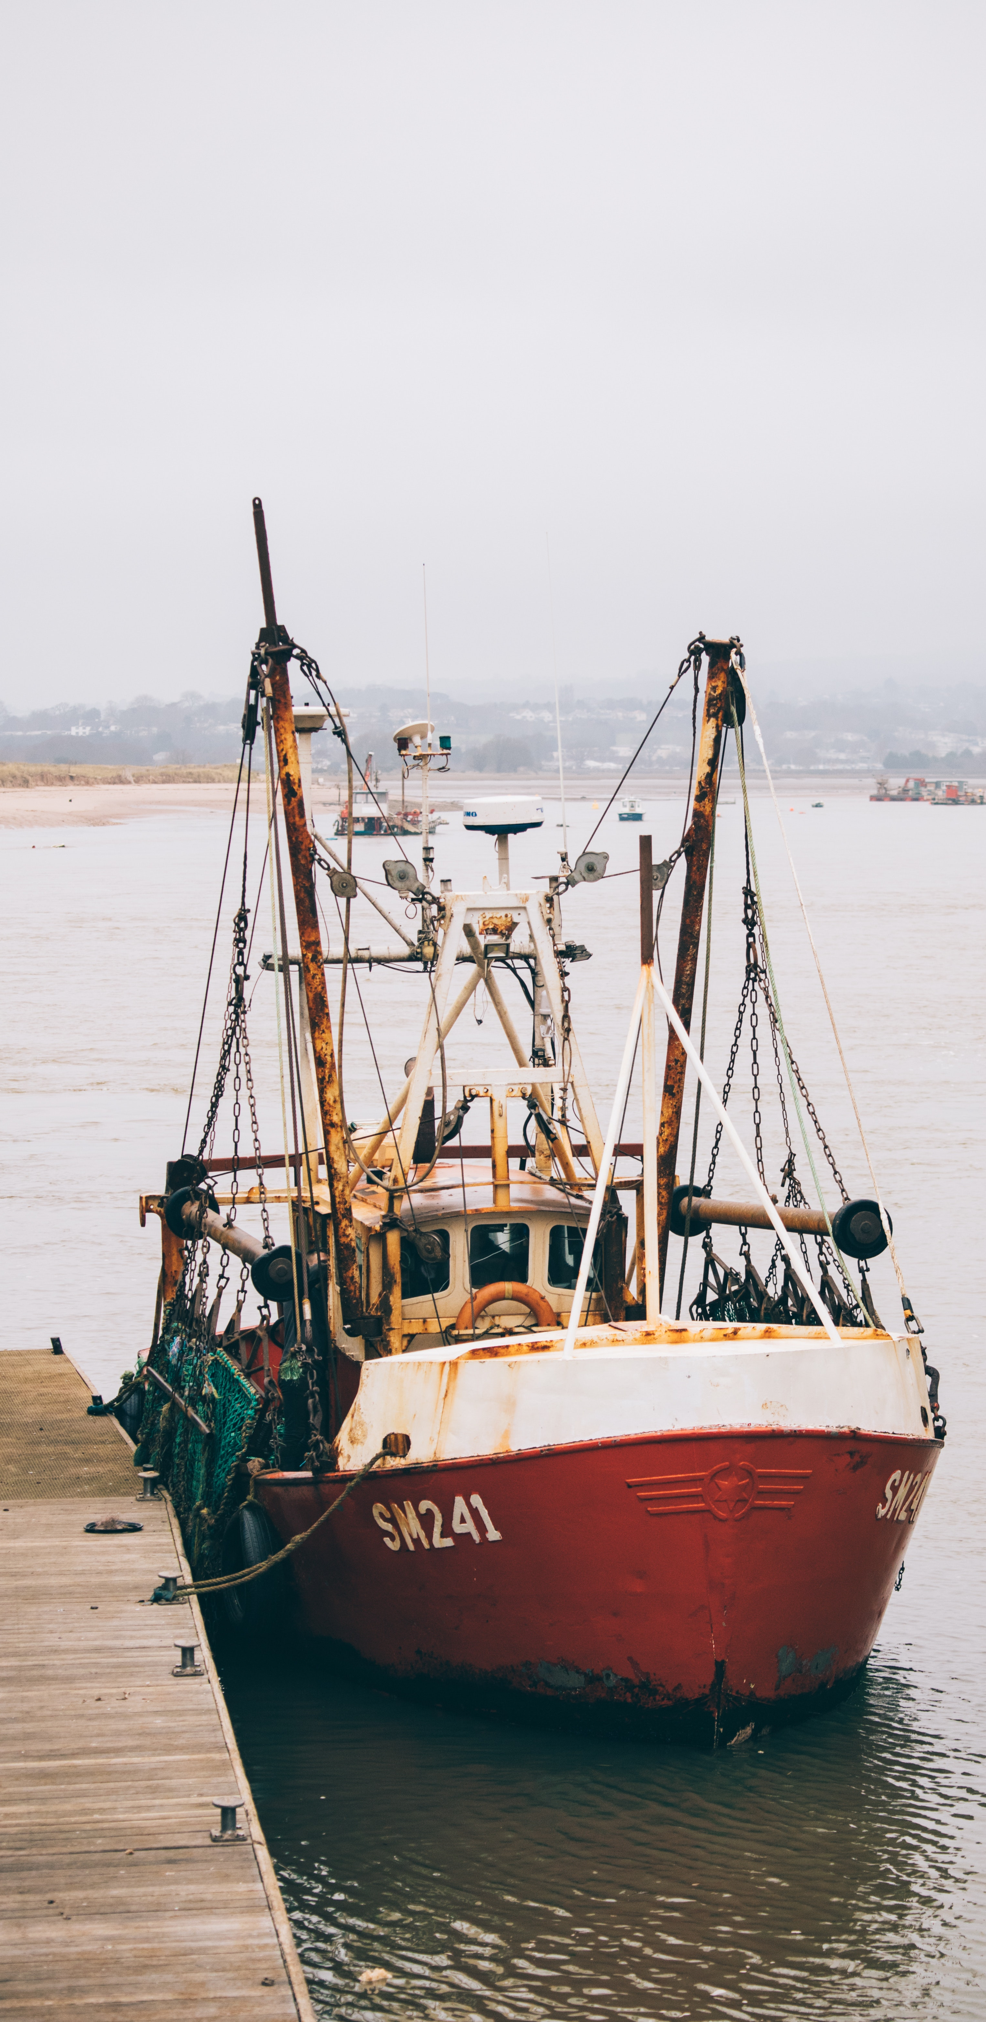
Why Are Our Seas Overfished?
Before the Blue Revolution
Throughout history, fishing has been an important way of food production, supporting many livelihoods and providing incomes.
As fishing became more popular and the population started to boom, the fishing industry expanded, and fishing methods have changed accordingly, in order to increase fishing boats’ efficiency and the size of catches (FAO).
Trawling became a popular method to increase catch size and the nets were designed to be extremely large, being able to be towed by a boat through the ocean.
They are either moved through the water column (midwater trawl) or along the sea floor (bottom trawl).
Bottom trawling often catches unwanted species of fish or other sea creatures (AFMA). This is known as bycatch.

Slide 6
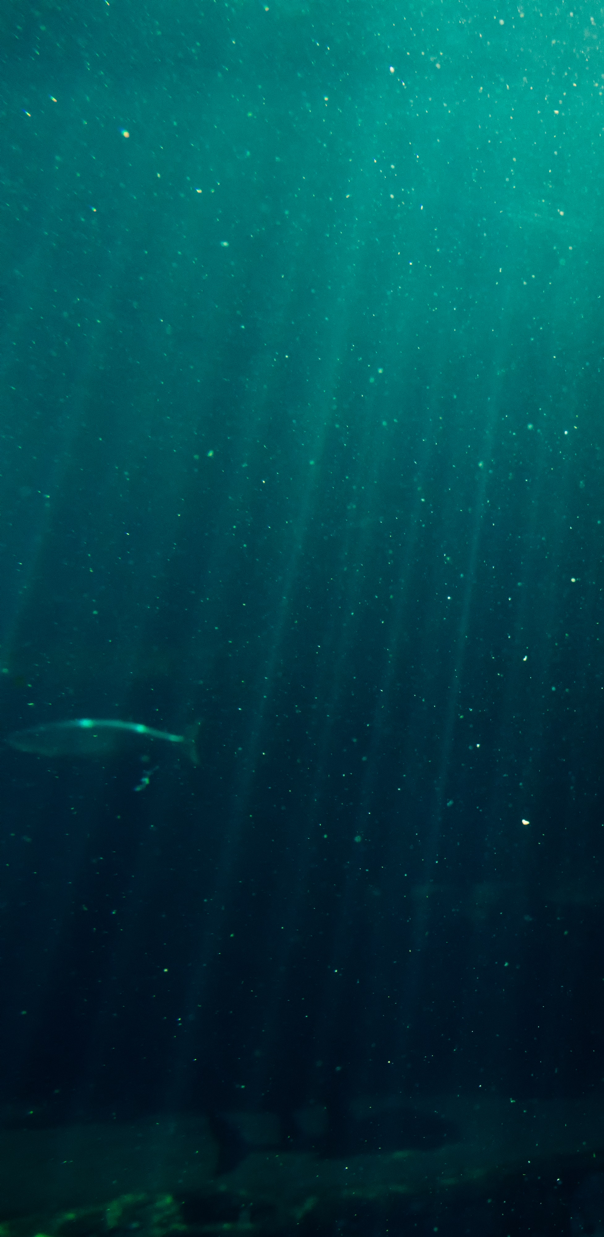
Why Are Our Seas Overfished?
Impact of Capture Fisheries
Bottom trawling is said to be one of the most destructive ways to catch fish, being responsible for up to half of all discarded fish and marine life worldwide (OCEANA).
Fishing industry leaders are increasingly realizing the need to reduce bycatch from trawling. Proven solutions do exist, such as modifying fishing gear so that fewer non-target species are caught or can escape (WWF).
However, despite new technologies and recognition of the issue, bycatch is still a major problem (WWF).
Does Aquaculture Help These Issues?
Aquaculture has reduced the demand on capture fisheries globally and it is a sustainable alternative that does not result in any bycatch – giving wild fish populations time to recover.

Slide 7
How Seafood is Caught: Bottom Trawling https://youtu.be/BcJFSl_YJHk
Mowi - Leading the Blue Revolution Plan
https://vimeo.com/379216639
Cargill - Sustainable Aquaculture
https://vimeo.com/382791164

Slide 8
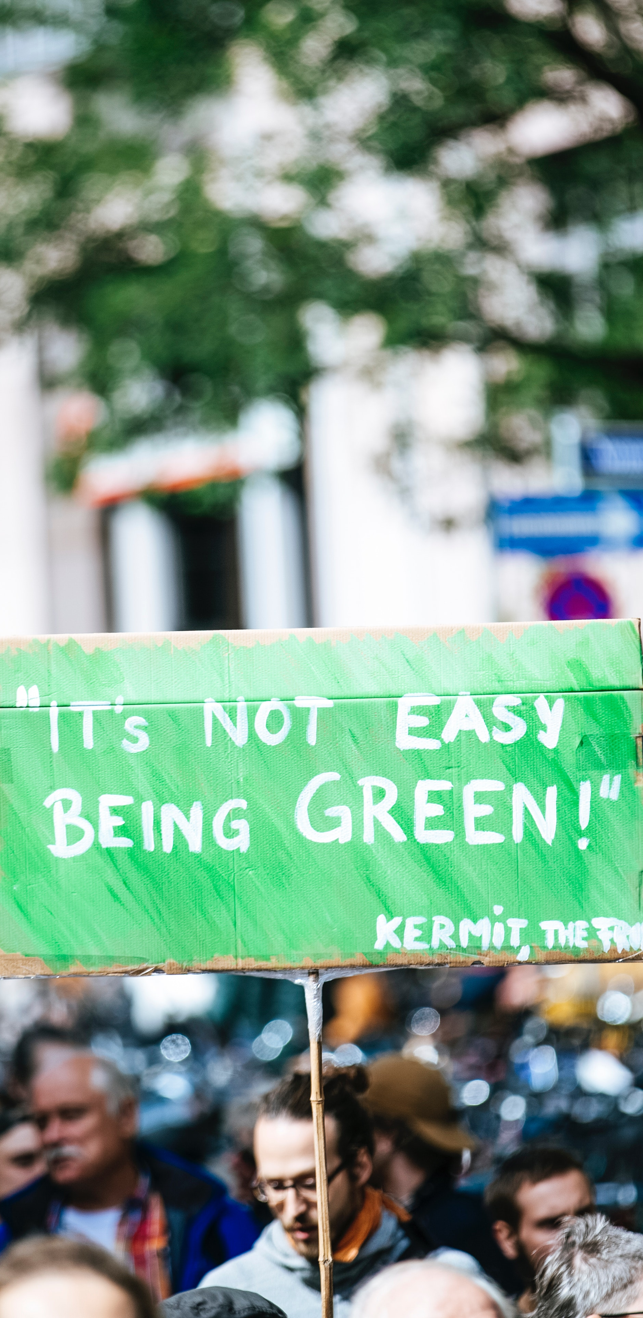
Does Aquaculture Have Issues?
Impact of Aquaculture
Like any growing industry, aquaculture has been faced with many challenges, and during the blue revolution many of these challenges were overcome.
Although Aquaculture aims to be sustainable and have low environmental impact, fish farms that are not managed correctly can have negative impacts on the environment.
Sustainable Aquaculture farms are a new way forward to ensure environmental impact is low at all times.
In comparison to capture fisheries and agriculture, environmental impact is extremely low, and it is a sustainable alternative fit for the future.
The main challenge facing aquaculture is in feeding. Currently, in order to feed the fish, other marine stocks are used. New ways, such as using insects for feeding, are being tested and put forward so aquaculture can fully reduce overfishing.

Slide 9
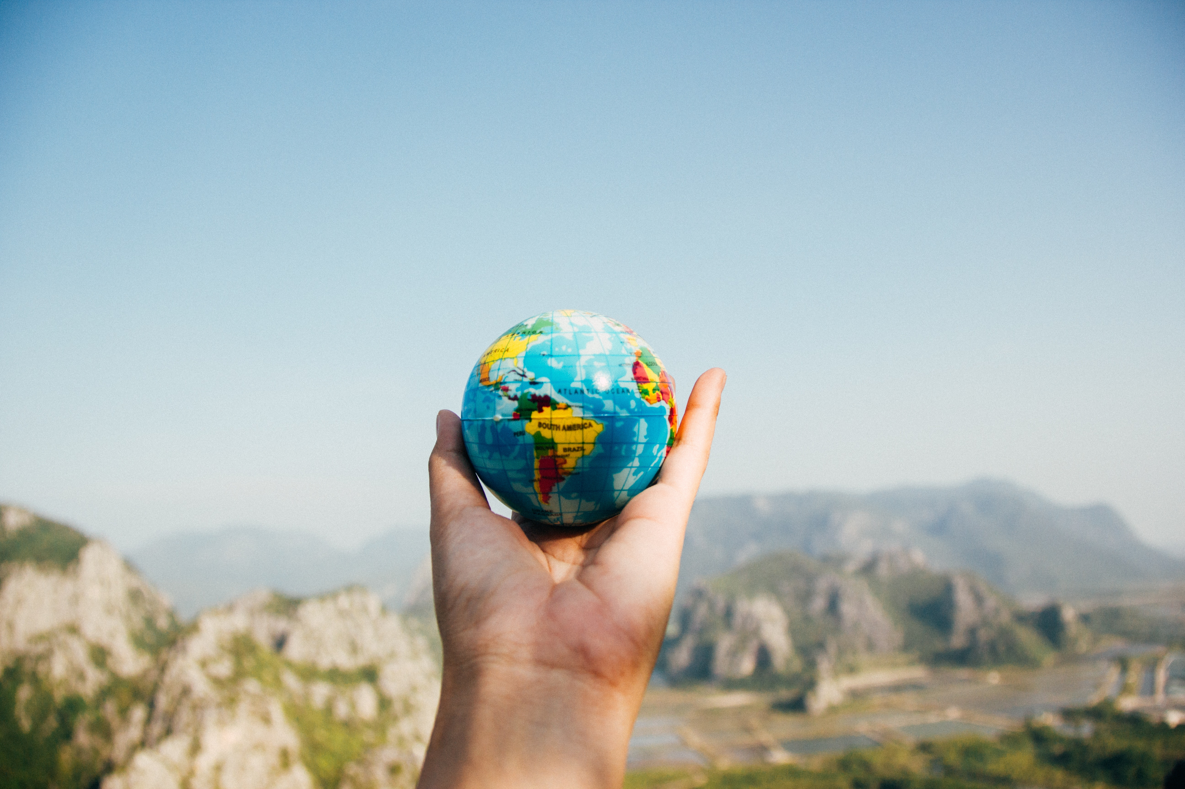
How Does Aquaculture Overcome Issues?
What Does a Sustainable Aquaculture Site Involve?
Developing new sustainable feeds that still provides the nutrients for the fish to grow (for example insect feed).
Fighting diseases, such as sea lice, to limit the risk to wild-stock fish and promote better fish welfare.
Bettering logistics: better transportation and keeping food miles low.
Following legislation to ensure nutrient enrichment remains low to limit the impact on sea-floor (benthic) species.
Careful site selection to limit the impact on the environment.
Waste Control – reduce risk of eutrophication.
Renewable sources of energy and on-site recycling of waste and energy.

Slide 10
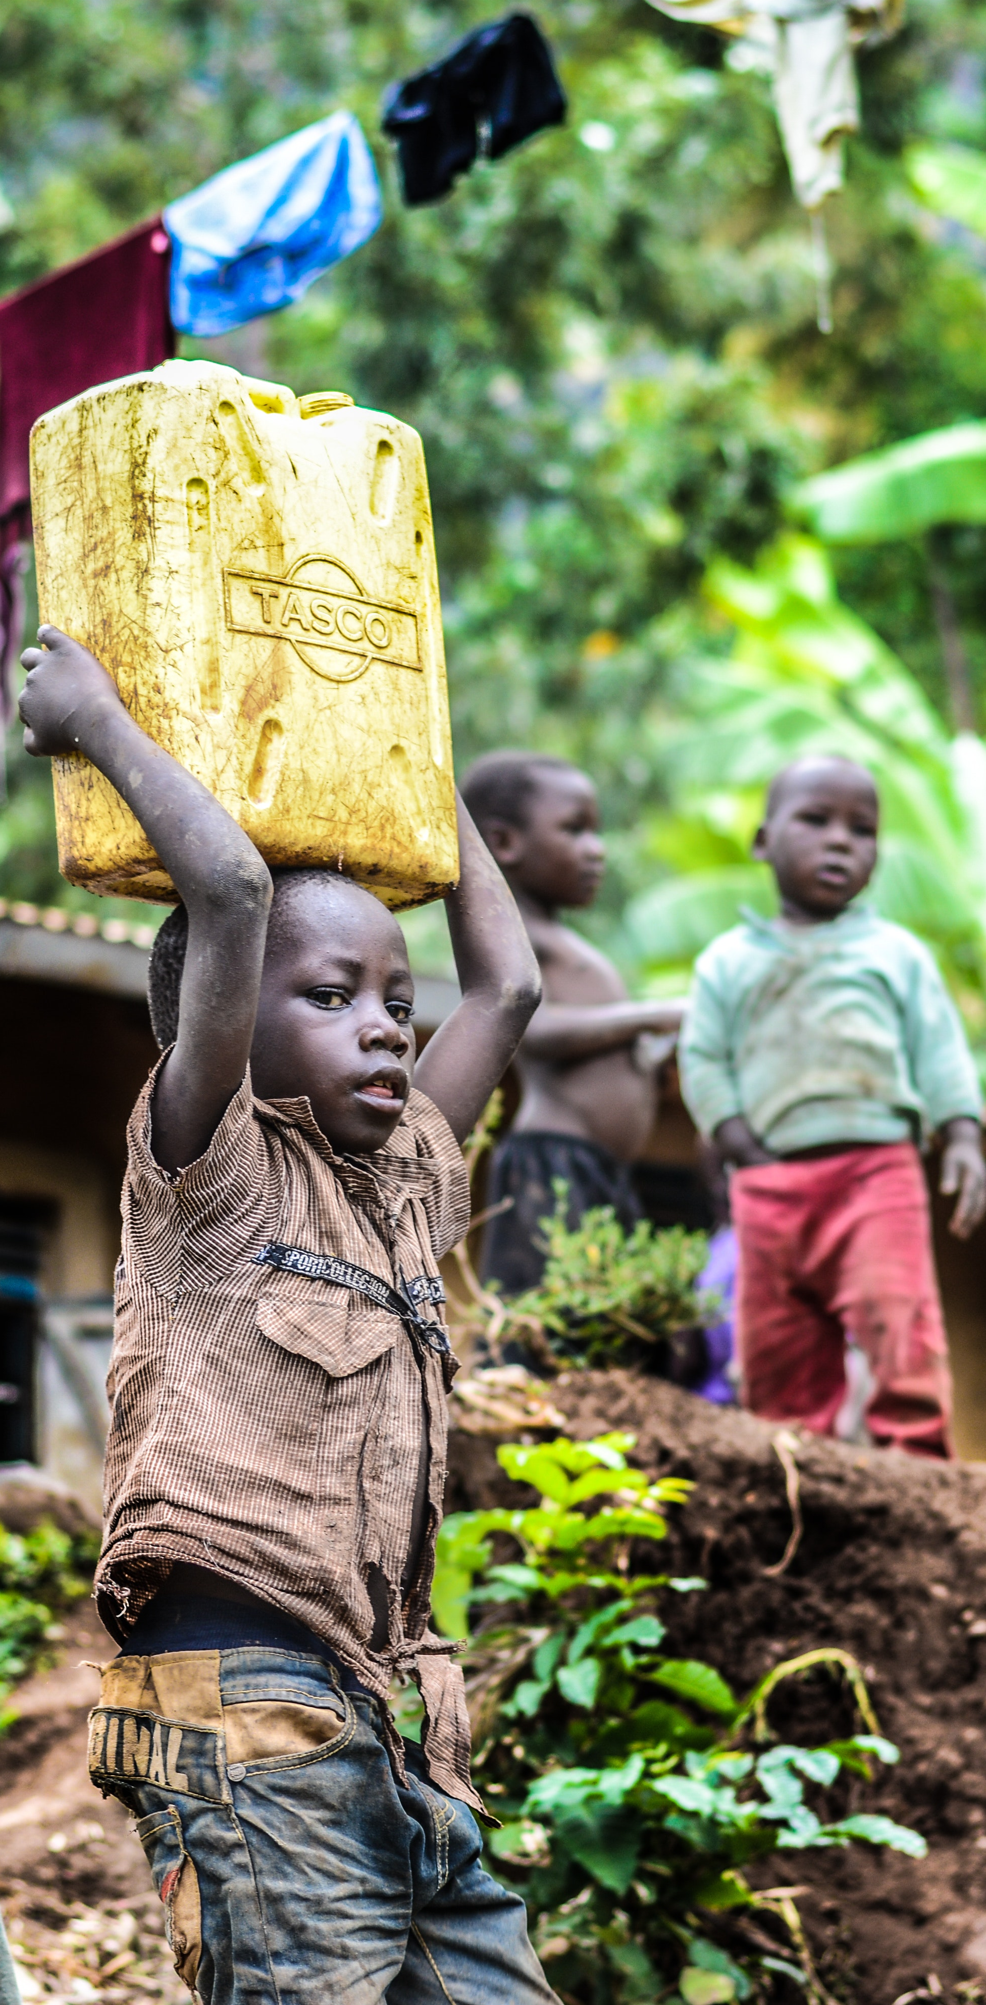
Blue Revolution in Developing Regions
Importance of Aquaculture
It is important that we show the benefits of aquaculture to developing regions and teach them our successes in aquaculture so far.
People in developing countries are very dependent on fish, providing them a basic livelihood. They deliver the largest volume of catch and production worldwide, employing 97% of the world's fishing workforce (WWF).
However, little is known about aquaculture practices.
Food insecurity is a very serious problem in developing regions – especially with the influence of climate change. Crop harvests are failing, and oceans have been overfished. They need new ways of living and feeding their families.
Developing countries also face many natural hazards, such as droughts, requiring them to be more resilient to deal with shocks. They need other alternatives in order to face future climate change and not rely on humanitarian aid.

Slide 11
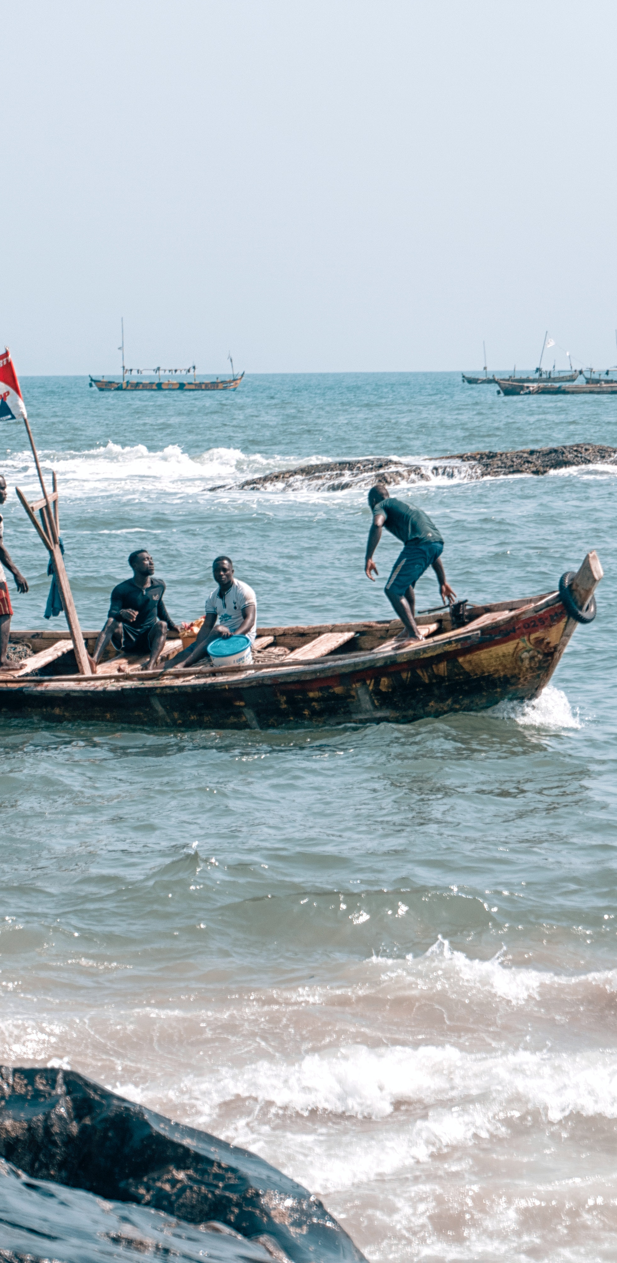
Blue Revolution in Developing Regions
Aiming to Achieve ‘Zero Hunger’
‘Zero Hunger’ is part of the United Nations: Global Sustainable Development Goals and the biggest challenge will be achieving this in developing regions, where there is vast amount of malnourishment and poverty.
Aquaculture provides people with jobs, money and nourishment to decrease poverty trends. Fish are a healthy source of protein and nutrition.
Many rural communities in developing regions, such as Zambia, have a starch-based diets, being a major problem (Humanity Africa Humanity Africa).
Monocropping has resulted in many people consume maize without many other sources of nutrition in their diet. Fish provides amino acids that improves the protein found in vegetables, and fatty acids, which are essential for brain and body development (Humanity Africa Humanity Africa).
Therefore, aquaculture has been acknowledged as being extremely beneficial for babies, children, pregnant women and people with illnesses, such as HIV.

Slide 12
OB Aquaculture Overview
https://vimeo.com/78915691
A Sustainable Aquaculture Success Story
https://vimeo.com/81234020

Slide 13
The Future of the Blue Revolution
Aquaculture Going Forward
Aquaculture, just like any other growing industry, is not perfect. However, its intensions are in the right place. Aquaculture wants to continue being sustainable while providing for a growing population.
Successes and failures in aquaculture in developed regions must be passed down to aquaculture in developing regions, to ensure we are all aiming for a sustainable future.
Aquaculture has the potential to make a massive difference in this world, especially for fragile rural/coastal communities and help us achieve any of the UN Global Sustainable Development Goals by 2030.
Our oceans need to re-populate and thrive once more. Aquaculture has the potential to ensure this.
With new science and ways of innovation, aquaculture can give us a sustainable future.

Slide 14
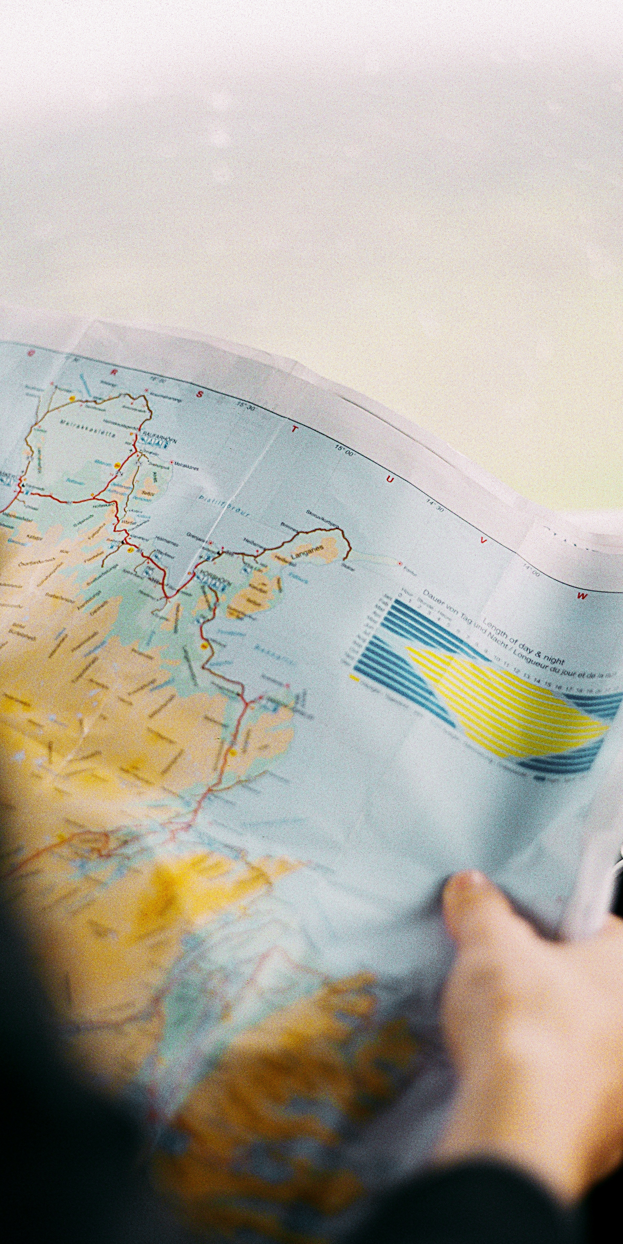
Restoring Fish Stocks
How Can Geographers Help?
Help develop a policy that ensures capture fisheries production stays below the Maximum Sustainable Yield (highest possible annual catch that can be sustained over time).
Help develop more sustainable feeds for Aquaculture that doesn’t rely on other marine life (in progress).
Carry out environmental checks and study the impact on the surrounding marine life to help ensure that aquaculture’s environmental risk remains low.
Help ensure that aquaculture in developed and developing regions is climate change resilient for future challenges.
Help promote good fish welfare in aquaculture. Help tackle escapees and disease to ensure wild-fish are not impacted through aquaculture practices.
Look at the food labels and eat from sustainable aquaculture sites.

Slide 15
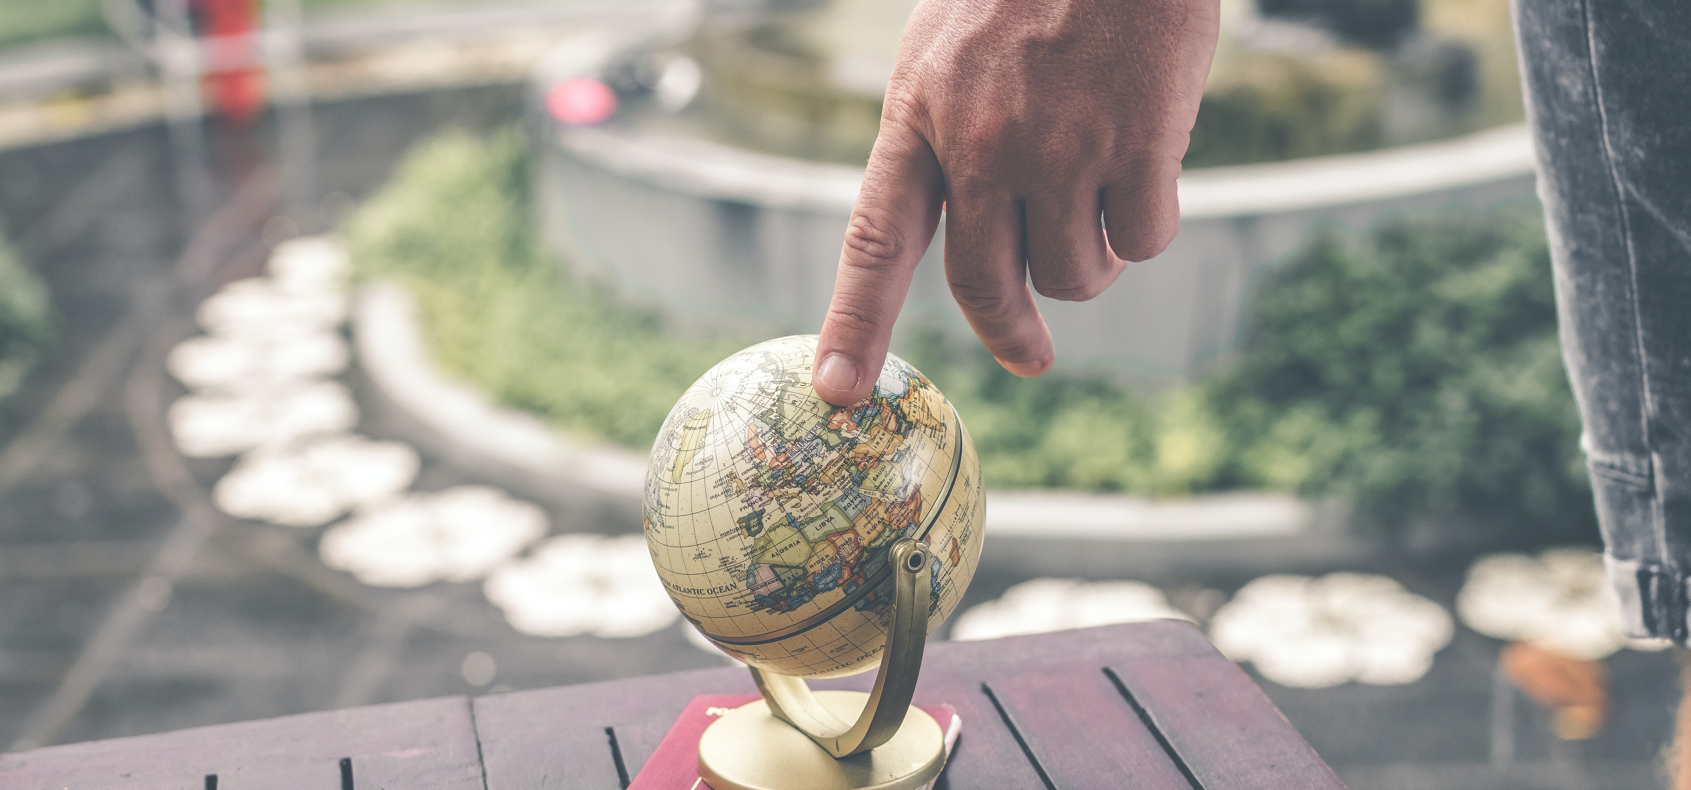
Aquaculture Needs Geographers
Help drive innovation and work on the front line to combat climate change and food insecurity.
Aquaculture offers many career opportunities for geographers.
Contact SAIC for more information on career opportunities.

